Slide 1
Capstone Project
Netflix Movies and TV Shows Clustering
By Tapomay Sahoo and Shivam Tiwari

Slide 2
Points for discussion
Know the project
EDA
Hypothesis Testing
Feature Engineering & Data pre-processing
Model Building
Conclusion

Slide 3
Know The Project

Slide 4
Problem Statement
Netflix is a very popular online streaming service provider offering a variety of TV shows, movies, documentaries, and lots more to watch.
We have the dataset containing the list of their TV shows, movies and the other content that they have on their platform. The list is procured from a third-party website and contains information until 2021.
We are supposed to offer insights from the dataset on Netflix and its content. We are also supposed to cluster the contents based on text features.

Slide 5
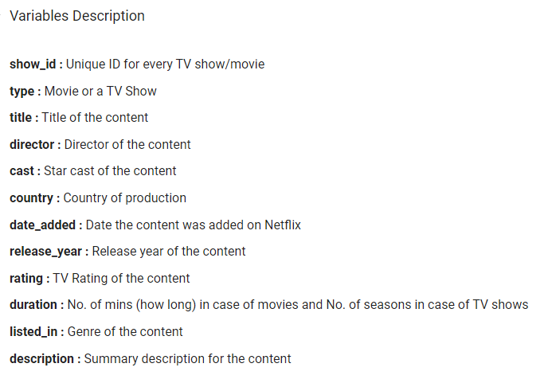
Data summary
From the first look, the dataset will need some cleaning.
Apart from the missing values, we have also encountered some discrepancies in the values for some of the columns after going through the Sheet.
We have 7787 datapoints and 12 columns. Most of the variables are text data. Only release year is numeric, but it is also discrete in nature.

Slide 6
EDA

Slide 7
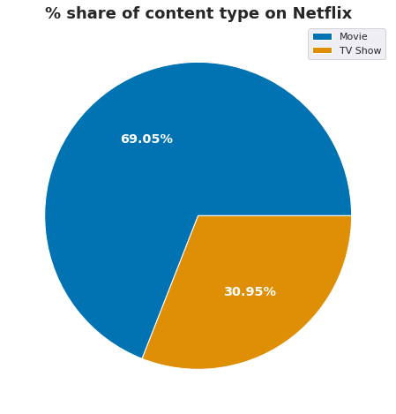
What is the distribution of content type on Netflix?
There are more than double the amount of Movies than TV Shows on Netflix.
Movies account for 69.05% whereas TV Shows account for 30.95% of the dataset.

Slide 8
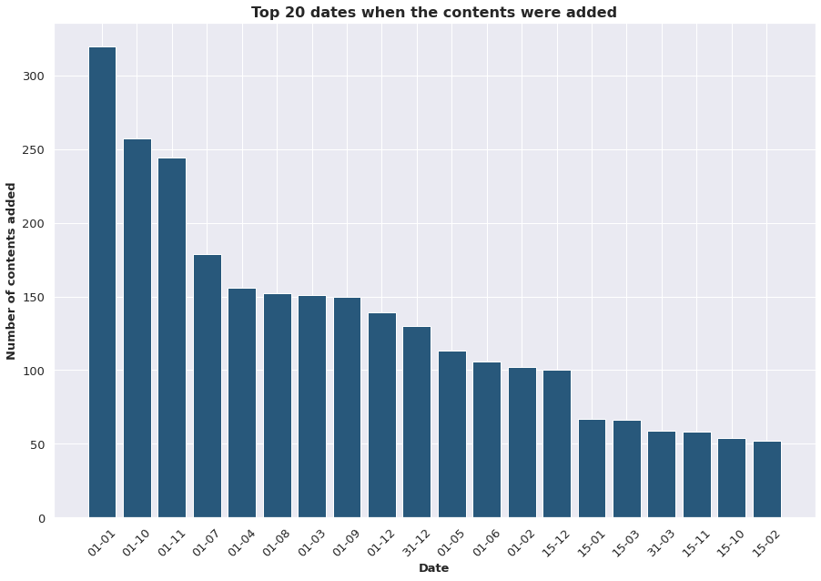
What are the top 20 dates when content were added on Netflix?
If we look at the distribution of the dates when the contents were added, the second half of a year (the holiday period) is usually when they add the content and it is either on the 1st or the 15th or the 31st.

Slide 9
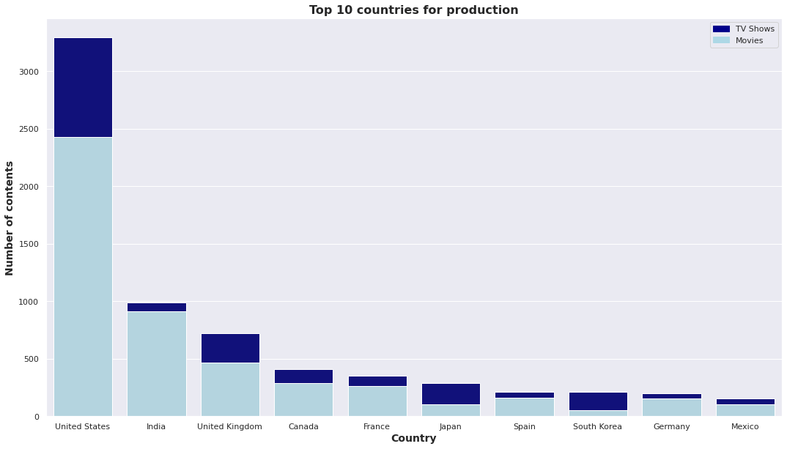
Which are the top 10 countries for content production on Netflix?
United States has the highest number of contents produced and it is three times in numbers when compared with the next best in line, India.
Countries generally focus a lot on movies, but there are exceptions. East Asian countries like Japan and South Korea produce more TV Shows than movies.
Whereas, a country like India could do a lot better in the TV Shows domain.

Slide 10
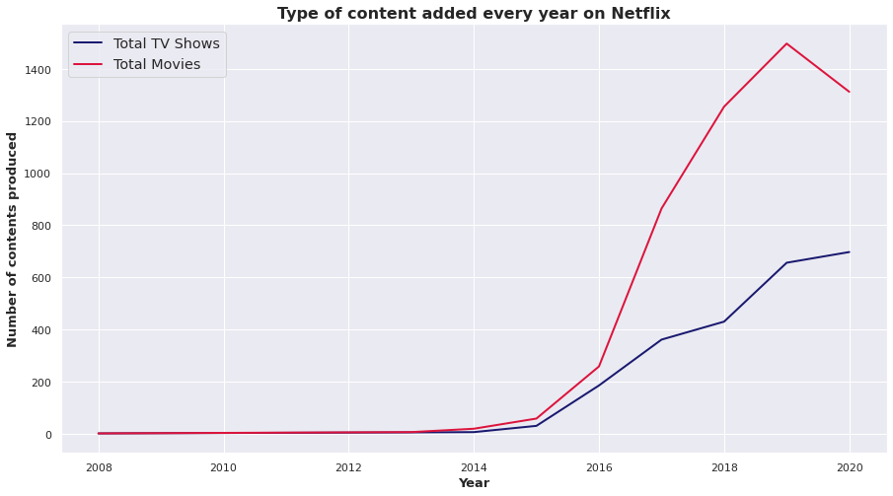
What is the distribution of the type of content for the different years?
Netflix really took off since 2015, before which the rate at which newer contents were added were quite slow. Also, while movies are added in large numbers, their growth has stopped and the numbers went down for the first time while going from 2019 to 2020.
While in contrast, TV Shows have almost shown a steady growth and never saw any kind of drop in numbers, not even going in 2020.

Slide 11
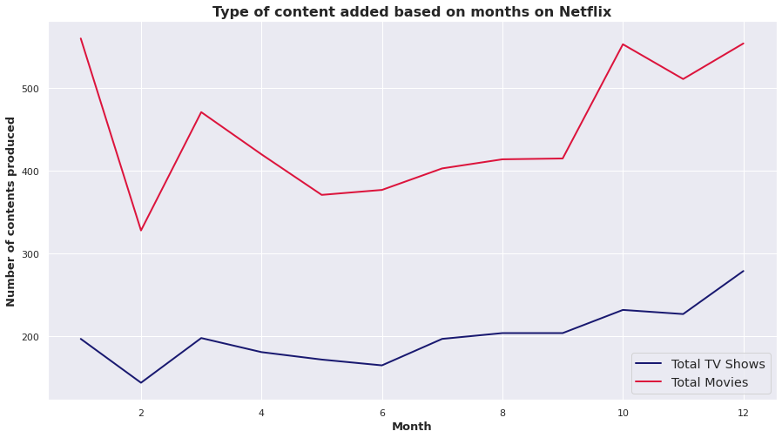
What is the distribution of type of content added for different months?
January, December, and October are the peak months. Whereas, February and May to September don't have many contents added, relatively. March has abnormal behaviour when compared with the rest of the months.

Slide 12
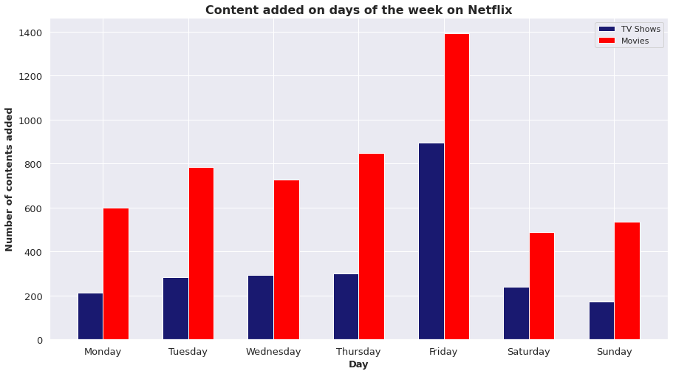
Which are the days of the week with most content added?
Weekends have the lowest number of releases. However, Friday has the highest of all the days of the week. Movies again are larger in number than TV Shows and the trend is almost similar between the two on all the days.

Slide 13
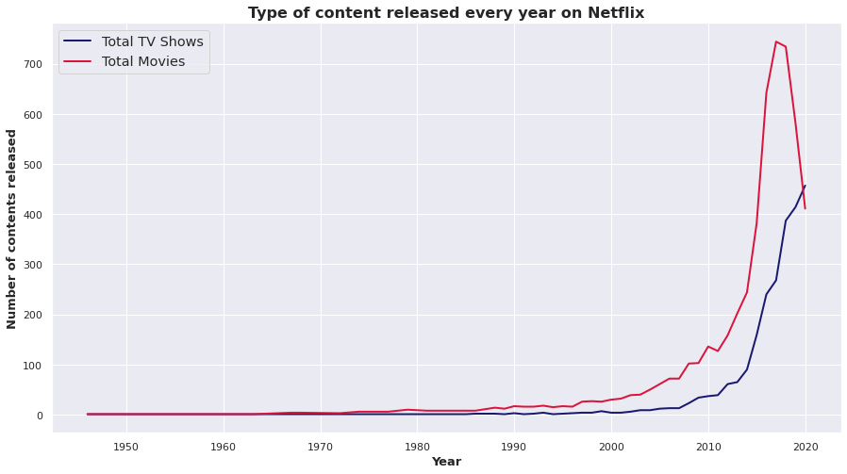
What is the trend in the contents released wrt the different years?
Again, the content released graph has very few surprises for us. The focus has shifted a lot on releasing newer TV shows more than movies.
So much has the focus shifted that for the first time ever, in 2020, the number of TV shows released surpassed the number of movie releases on Netflix.

Slide 14
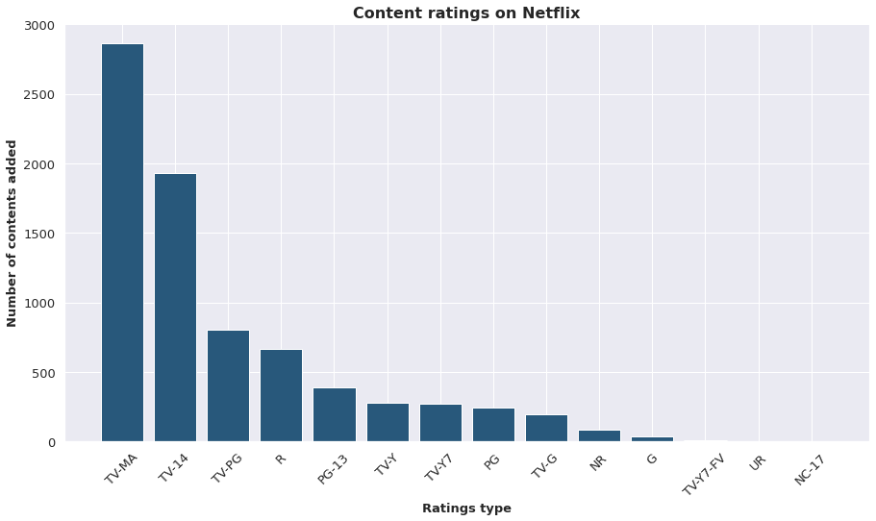
What is the distribution of TV ratings among the content on Netflix?
Contents suitable for all are very few in number whereas contents with restrictions like TV-MA (unsuitable for under 17), TV-14 (may be unsuitable for under 14) and TV-PG (unsuitable for young children) are the three highest in numbers.

Slide 15
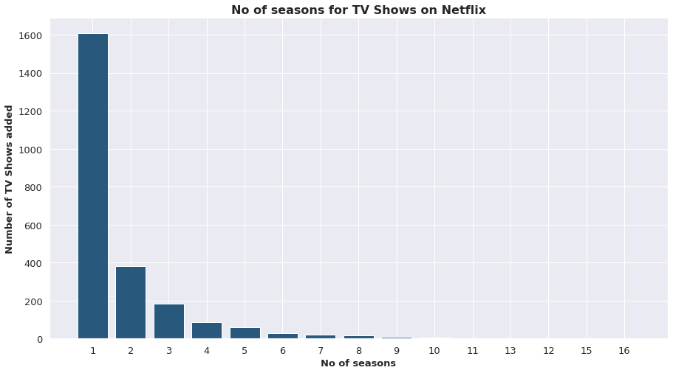
What is the distribution of the number of seasons for TV shows on Netflix?
A lot of TV Shows (more than 1600) have only one season. Almost 400 have two and there is almost an exponential decrement in the number of TV Shows with even larger number of seasons.

Slide 16
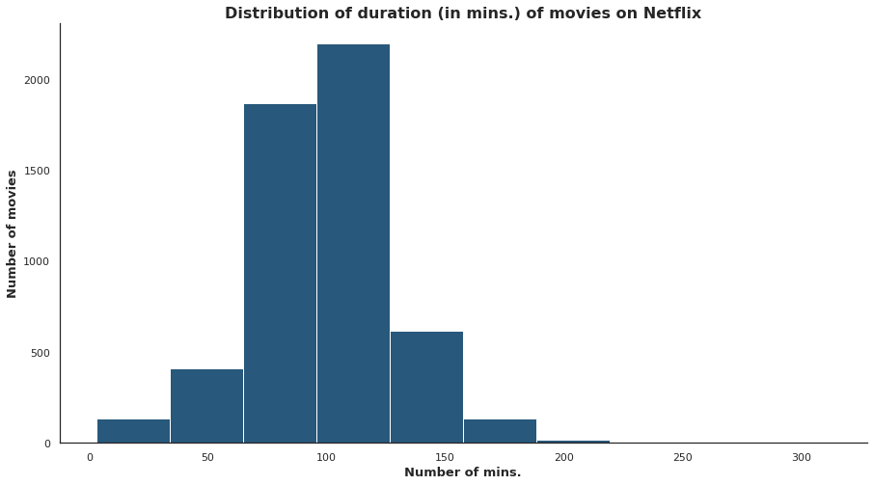
What is the distribution of duration of movies on Netflix?
A lot of the movies are between 60 to 150 mins long. But there are movies with more than 300+ minutes duration.

Slide 17
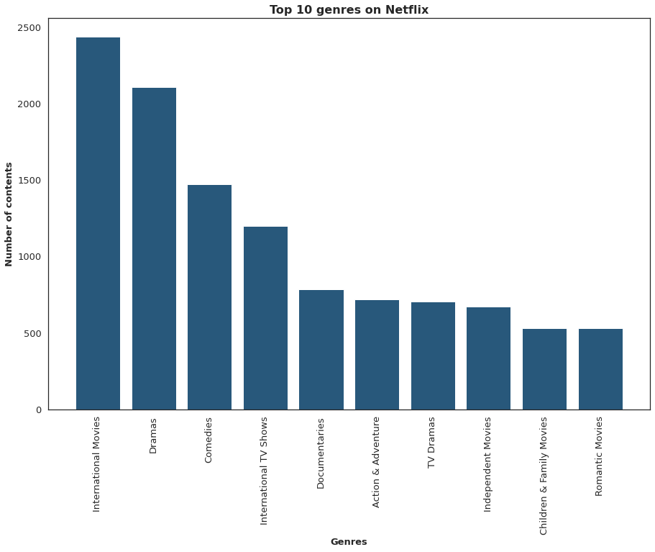
What are the top 10 genres on Netflix?
International TV Shows and International Movies are two of the most dominant genres. Others include Dramas, Comedies, Documentaries and Action & Adventure.

Slide 18
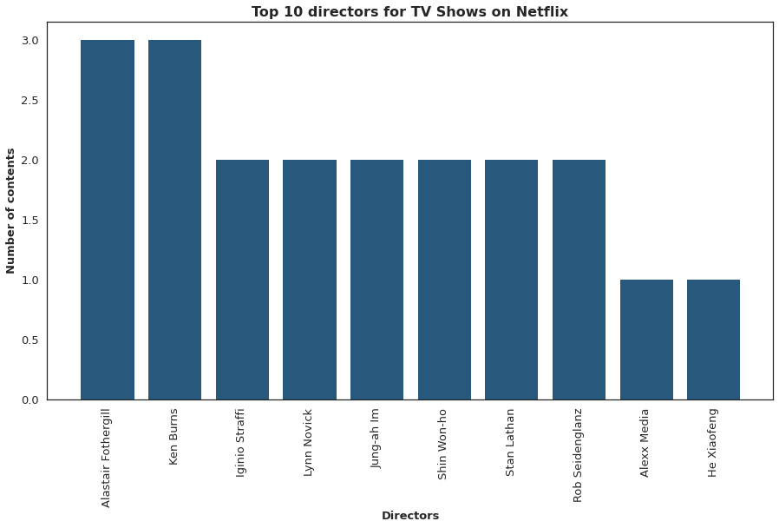
Who are the top 10 directors of TV Shows on Netflix?
The top 10 TV shows directors on Netflix doesn't feature directors with more than 3 TV Shows on the streaming service.

Slide 19
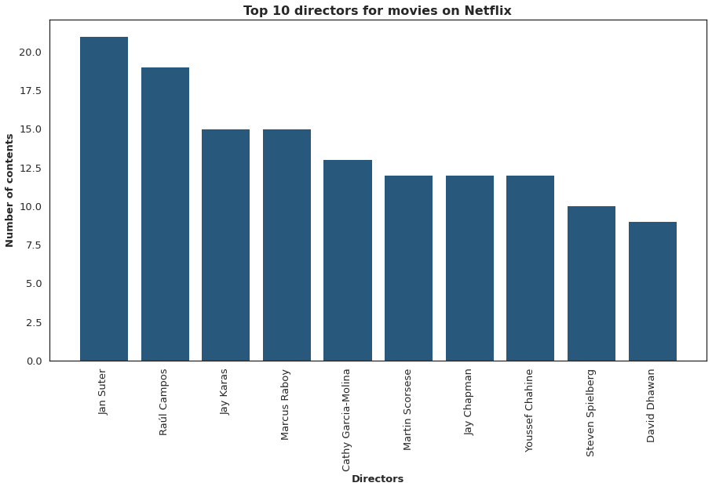
Who are the top 10 directors for movies on Netflix?
Some of the biggest names of the industry like Steven Spielberg, Martin Scorsese and Jay Chapman feature in the list of top 10 movie directors on Netflix.

Slide 20
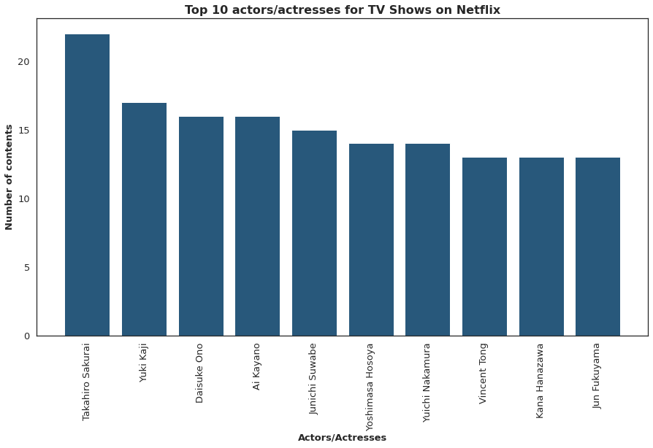
Who are the top 10 actors/actresses for TV Shows on Netflix?
A lot of Asians, perhaps East Asian actors feature on the list of top 10 actors/actresses for TV Shows on Netflix.

Slide 21
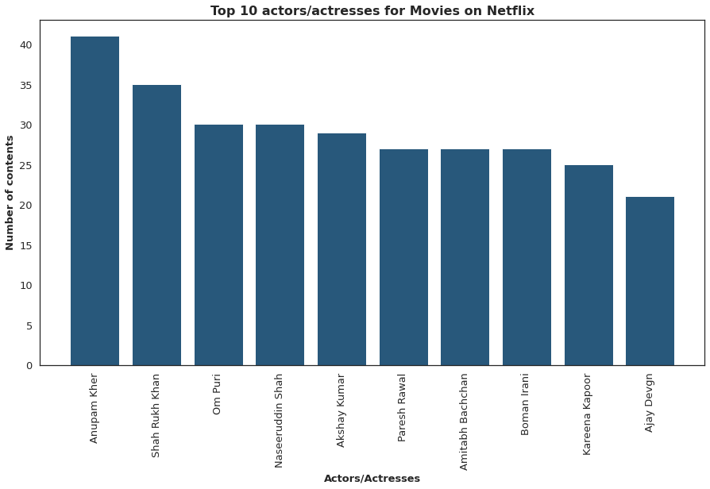
Who are the top 10 actors/actresses for movies on Netflix?
The list is full of A-listers from Bollywood, as expected given the number of movies from India on Netflix.

Slide 22
Hypothesis Testing

Slide 23
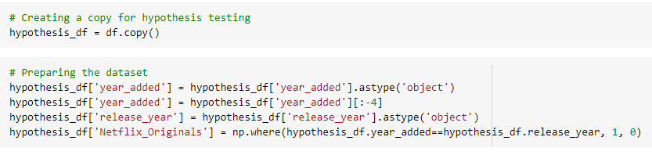
Preparing the dataset
We have decided to do hypothesis testing on the Netflix Originals content.
Netflix Originals are the movies and TV Shows that Netflix has produced and released exclusively on their streaming platform.
And so, to separate them from the others, we have assumed that the contents released and added in the same year are Netflix Originals’ content.

Slide 24
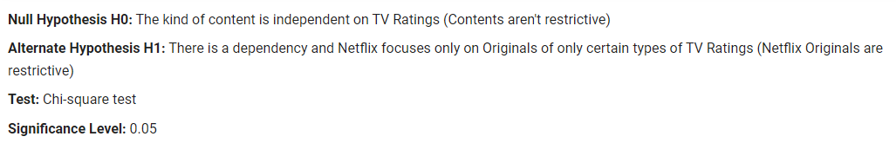
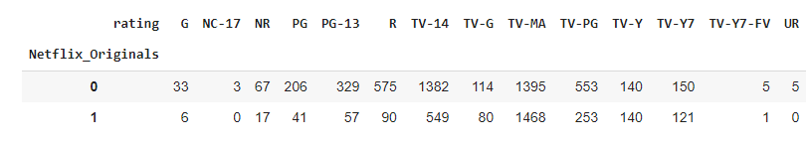
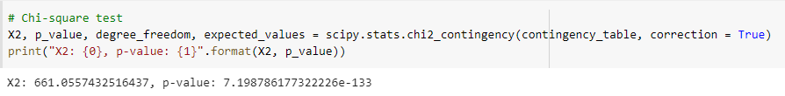
Hypothesis Testing - 1: Relation between Originals and TV ratings
Given our very low p-value, we have to reject the null hypothesis that there is difference in the TV ratings for Netflix's original and non-original contents. There is significant evidence to reject the null hypothesis.

Slide 25
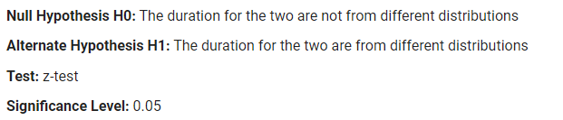
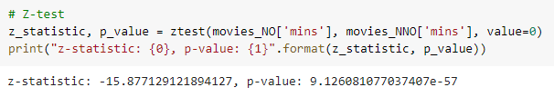
Hypothesis Testing - 2: Checking the difference in duration of Netflix Originals Movies and other movies
Since the p-value is very low, we will once again reject the null hypothesis that the duration of the Netflix Original movies and the other movies are not from two different distributions.

Slide 26
Feature Engineering & Data Pre-Processing

Slide 27
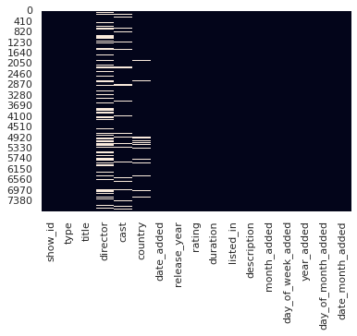
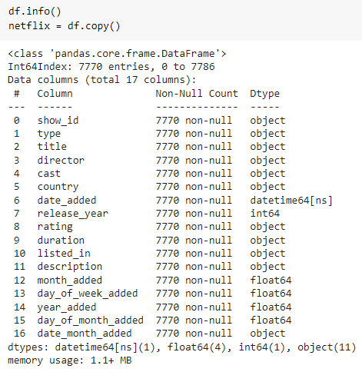

Dealing with Outliers and Null Values
Clustering will see a lot of categorical or text-based (object) variables grouped into one big text variable and then worked on. So, we can impute the missing values from director, cast and country with an empty space.
As for date_added and the columns generated using it and the rating column, we will delete the rows with missing values.
There are no numeric columns that may have the possibility of having outliers of no importance. And so we are skipping this step.

Slide 28


Categorical Encoding and Data Scaling
We have dummy encoded the two categorical variables (non-text data) that existed and are not to be joined later for the TF-IDF process.
As for the numerical columns, we applied MinMaxScaler to make the data be between 0 and 1.

Slide 29

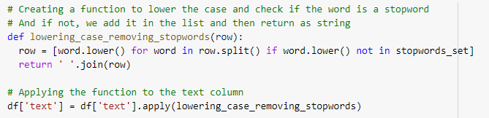
Combining Text Data, Lowering Case and Removing Stopwords
We joined all the textual data into one column and deleted all the columns we knew are now not relevant with the clustering process.
We removed all the stopwords from our text data and also have lowered the case for the words in all the documents of the corpus.

Slide 30
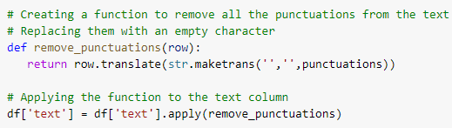
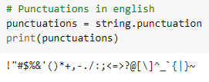


Removing Punctuations and Stemming
We have removed all the punctuations from the text column of the dataset.
We have stemmed all the words to their roots from the text column of the dataset.

Slide 31


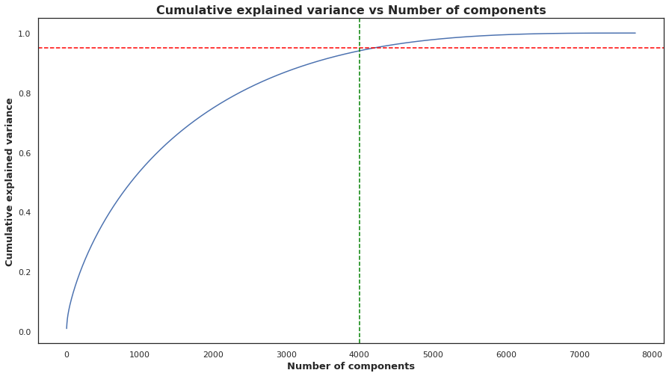

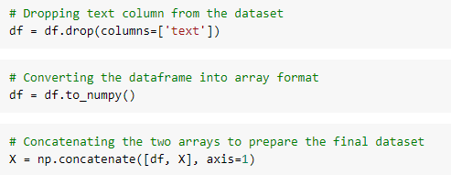
Text Vectorisation and Dimensionality Reduction
We have vectorised the text using the TF-IDF text vectorisation technique.
We can see that the first 4000 components explain 95% of the variance and thus we will use only those.

Slide 32
Model Building

Slide 33
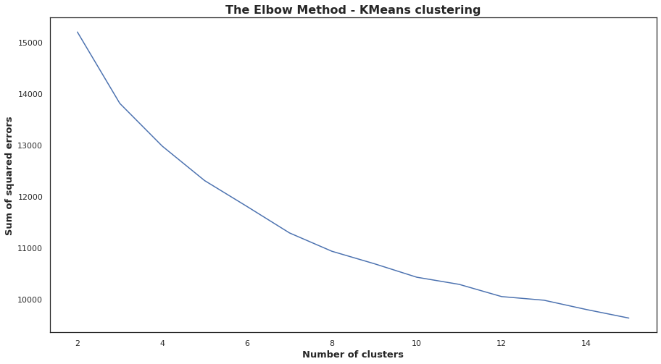
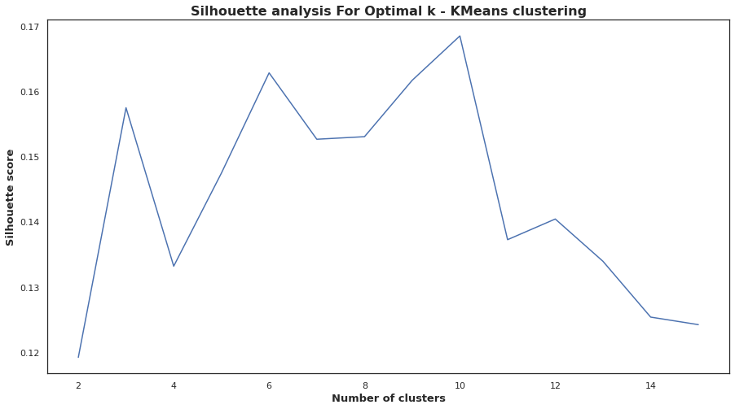
K Means Clustering
The elbow method technically fails in our case as it gives us a very smooth curve. However, from the silhouette score, we can say that 10 is the right number of clusters for our problem.

Slide 34
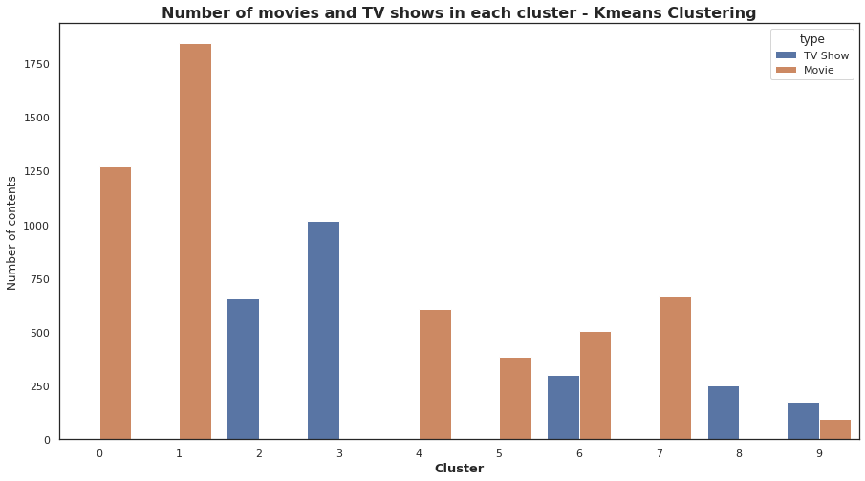
K Means Clustering

Slide 35
K Means - Clusters Analysis
Cluster 0: TV-14 rated movie cluster from countries like India, US, UK, Germany, France, Indonesia, Nigeria and many more. Popular genre among this cluster includes International Movies, Romantic Movies, Comedies, Action Movies and Dramas.
Cluster 1: TV-MA rated movie cluster from countries like US, UK, India, Canada and France. Popular genre among this cluster includes Documentaries, Comedies, Dramas International, Thriller Movies, Drama Movies and many more.
Cluster 2: TV-14 rated TV show cluster from Asian countries Taiwan, China, Singapore, Japan, South Korea apart from the regulars UK and US. Romantic TV Shows, Korean TV, International TV, TV Comedies and Anime Series are some of the popular genres.
Cluster 3: TV-MA rated TV show cluster primarily from US, UK, South Korea, Japan, Brazil, Mexico, Spain and France. Popular genres include Crime TV, Spanish Language, Spanish Shows, International TV Shows, Language TV and TV Comedies.
Cluster 4: Movies of various kinds of ratings mainly from US, UK, Australia, Germany, India and France. Popular genres are Comedy Movies, Children Movies, Family Movies, Documentaries and Sports Movies.
Cluster 5: PG-13 rated movies mainly from US and UK. Very few other countries appear. Genres from the cluster are Action, Adventure, Sci-Fi, Fiction Fantasy and Horror Movies.
Cluster 6: TV-PG rated cluster of both movies and TV Shows from US, UK, India, Japan, Canada, Australia and Indonesia. Popular genres include International TV, International Movies, Children Movies and Reality TV.
Cluster 7: R rated movies from US, UK, Canada, Germany and France. A lot of Independent Movies, Horror Movies, Thriller Movies and Action Adventure feature in the cluster.
Cluster 8: TV-G and TV-Y rated TV Shows from US, UK, South Korea, Canada and India. Popular genres from the cluster are Kids TV, Comedies Kids, British TV, Reality TV and Docuseries.
Cluster 9: TV-Y7 rated TV shows and movies from US, Japan, UK, South Korea and Canada. The top genres are Family Movies, Kids TV, Kids Movies and Comedies.

Slide 36
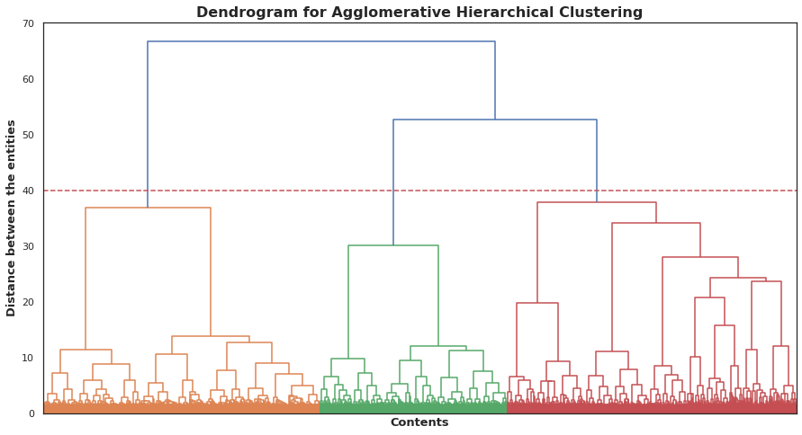
Hierarchical Clustering

Slide 37
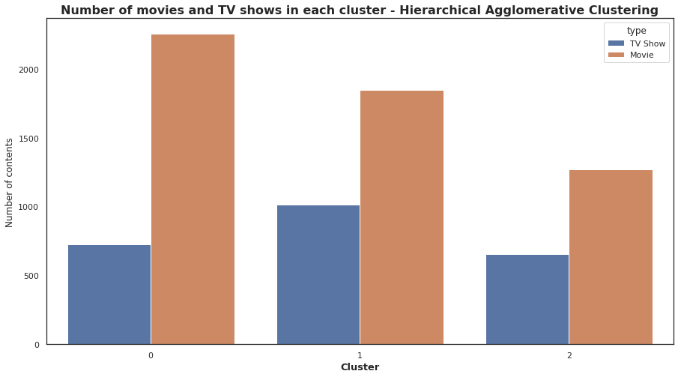
Hierarchical Clustering

Slide 38
Hierarchical Clustering - Cluster Analysis
Cluster 0: Contains TV shows and movies of all kinds of ratings except for TV-14 and TV-MA. US, UK, Canada and France seem to be the most popular countries whereas Family Movies, Kids TV, Comedies and Action Adventure are some of the popular genres.
Cluster 1: Contains TV shows and movies of TV-MA rating. US, UK, India, France, Canada and Spain are the popular countries. Genres that are popular in this cluster are TV Dramas, Crime TV, International Movies and International Dramas.
Cluster 2: Contains TV shows and movies of TV-14 rating. India, US, Philippines, South Korea, China and Egypt are the popular countries. International Movies, International TV, Comedies, Musicals and Romantic Shows are the popular genres.

Slide 39
Final Model
Given the nature of the clusters formed by Hierarchical Clustering, there aren't much separation done based on some important features.
The three clusters are just divided based as follows: the contents with the two most dominant TV ratings are two of the three clusters and the rest of the content is clubbed in the final cluster.
And so, if we were to decide which one to choose as the final model, we will perhaps go ahead with the KMeans Clusters. However, this call also depends on the business domain and the requirements of the main stakeholders of the projects.

Slide 40
Conclusion

Slide 41
Conclusion
There are more than double the amount of Movies than TV Shows on Netflix. Movies account for 69.05% whereas TV Shows account for 30.95% of the dataset.
If we look at the distribution of the dates when the contents were added, the second half of a year (the holiday period) is usually when they add the content and it is either on the 1st or the 15th or the 31st.
United States has the highest number of contents produced and it is three times in numbers when compared with the next best in line, India.
Countries generally focus a lot on movies, but there are exceptions. East Asian countries like Japan and South Korea produce more TV Shows than movies.
Whereas, a country like India could do a lot better in the TV Shows domain.

Slide 42
Conclusion
Netflix really took off since 2015, before which the rate at which newer contents were added were quite slow. Also, while movies are added in large numbers, their growth has stopped and the numbers went down for the first time while going from 2019 to 2020.
While in contrast, TV Shows have almost shown a steady growth and never saw any kind of drop in numbers, not even going in 2020.
January, December and October are the peak months. Whereas, February and May to September don't have much contents added, relatively. March has an abnormal behaviour when compared with the rest of the months.
Weekends have the lowest number of releases. However, Friday has the highest of all the days of the week. Movies again are larger in number than TV Shows and the trend is almost similar between the two on all the days.
Again, the content released graph has very little surprises for us. The focus has shifted a lot on releasing newer TV shows more than movies. So much has the focus shifted that for the first time ever, in 2020, the number of TV shows released surpassed the number of movie releases on Netflix.

Slide 43
Conclusion
Contents suitable for all are very few in number whereas contents with restrictions like TV-MA (unsuitable for under 17), TV-14 (may be unsuitable for under 14) and TV-PG (unsuitable for young children) are the three highest in numbers.
A lot of TV Shows (more than 1600) have only one season. Almost 400 have two and there is almost an exponential decrement in the number of TV Shows with even larger number of seasons.
A lot of the movies are between 60 to 150 mins long. But there are movies with more than 300+ minutes duration.
International TV Shows and International Movies are two of the most dominant genres. Others include Dramas, Comedies, Documentaries and Action & Adventure.
The top 10 TV shows directors on Netflix doesn't feature directors with more than 3 TV Shows on the streaming service.
Some of the biggest names of the industry like Steven Spielberg, Martin Scorsese and Jay Chapman feature in the list of top 10 movie directors on Netflix.

Slide 44
Conclusion
A lot of Asian, perhaps East Asian actors feature on the list of top 10 actors/actresses for TV Shows on Netflix.
The list of top 10 movies actors is full of A-listers from Bollywood, as expected given the number of movies from India on Netflix.
Given our very low p-value, we had to reject the null hypothesis that there is difference in the TV ratings for Netflix's original and non-original contents. There is significant evidence to reject the null hypothesis.
Since the p-value is very low, we will once again reject the null hypothesis that the duration of the Netflix Original movies and the other movies are not from two different distribution.

Slide 45
Thank You

